Slide 1
Well-Being & Doing Well at Work!
Maximizing the Potential & Productivity of Military-Connected Talent
As tens of thousands of military veterans transition to the civilian workplace each year organizations across all industries look to maximize both the potential and the productivity of these highly-skilled and engaged employees. Whether it’s finding and attracting these candidates, implementing an efficient and effective hiring and onboarding program, or creating a culture that fosters the productivity and retention of military connected talent each of you play a vital role within your military connected employment programs AND the overall well-being of military connected employees.
This interactive online session on how to maximize the productivity and potential of military connected talent features PsychArmor’s Andrew Morton (Army veteran, veteran employment author, and Mental Health Counselor). Andrew has spent the last decade helping organizations build veteran-ready employment initiatives that maximize both the well-being and “well-doing” of these employees. Whether you’re a part of your organization’s talent acquisition / Human Resources team or serve as people manager/ leader within your organization you’ll gain a better understanding of both the business case and business of veteran-ready. Andrew’s unique ability to provide specific resources and tools as well as connect through storytelling will have you leave this session both empowered and inspired as you serve to elevate your veteran employment and retention initiatives!
The Zoom link for the pre-session event is: https://mt-gov.zoom.us/j/83481297387?pwd=VU02Q2V2TWFQbzc3OElzRWxxZ1hSUT09

Slide 2

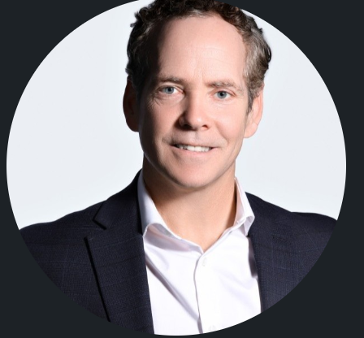

Andrew Morton, MIC
Resident in Counseling
Andrew Morton currently serves as Lead of Strategy and Partnership at PsychArmor’s . Andrew is retired Army Infantry Officer with a combined 30 years of service and experience within the military community, employment and behavioral health space. He has served on various boards and advisory commissions across the Department of Labor, Veterans Services Organizations, and the private sector focused on employment, retention, and inclusive work-place practices.
Andrew’s first-person journey as veteran and military spouse has instilled a passion for behavior and mental health initiatives. He has a Masters in Mental Health Counseling from the College of William and Mary and is a resident mental health counselor providing therapy to veterans and military family members through multiple non-profits.
Andrew lives in Old Town Alexandria, Virginia with his wife Emily, as well as his three children- and a myriad of animals.
Lead, Strategies and Partnerships
Amorton@psycharmor.org

